Slide 1
The Kilmer Browns

Slide 2
Will graduated high school 4 years ago and is finishing up his last year at ASU

Slide 3
Callie will graduate high school in the spring and is currently applying to colleges

Slide 4
We took a 3 day canoe adventure into Dominguez Canyon, a fairly new wilderness area in CO

Slide 5
Our blessed Mom made it to 90, but died in 2015

Slide 6
We Were honored to celebrate Marilyn and Jess’ wedding in NYC and to spend some time with some of you in Rocky National Park

Slide 7
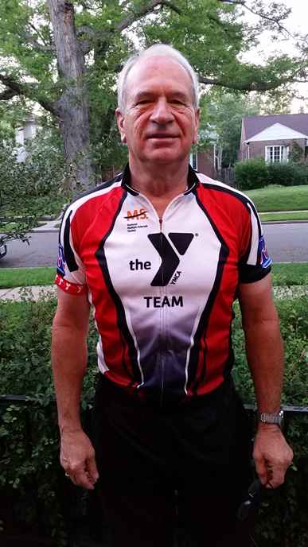
Steve got two new knees and is now a bicycle fiend

Slide 8
We celebrated our 25th anniversary this year, including a trip to Napa and Mendocino

Slide 9
And the kids say “Hi!”

