Slide 1
STEM Books: Springboard for STEM learning

Slide 2
Why Incorporate STEM Books?
It’s more than just reading!
Literacy + STEM = natural partners. Books help students to act like “STEMists” as they read, write, speak, and listen.
Simple tools¹ for introducing STEM concepts.
Enriches STEM learning with words, images, concrete and abstract concepts.
¹ Supports Next Generation Science Standards

Slide 3
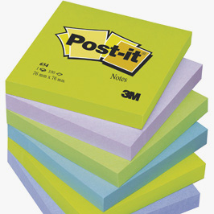
5 Tips for Using Integrating STEM Books
ENGAGE
Cover book with sticky notes & remove 1 at at time to get kids guessing at your topic.
Draw a Venn diagram to compare students’ predictions vs. book content.
Have students record/draw information.

Slide 4
5 Tips for Using Integrating STEM Books
EXPLORE
Bring in props related to the book’s content.
Ask questions about the book’s STEM content.
Point out STEM content (states of matter, etc.).

Slide 5
5 Tips for Using Integrating STEM Books
EXPLAIN
Describe how the STEM information unfolds.
Ask students to describe some of these changes.
Show ways to deconstruct or interpret any STEM diagrams or visuals in the book.

Slide 6
5 Tips for Using Integrating STEM Books
ELABORATE
Have students describe the STEM content in their own words.
Encourage students to create their own stories based on STEM content in the book.
Students investigate to learn more about the topic.

Slide 7
5 Tips for Using Integrating STEM Books
EVALUATE
Ask questions – what do you now know about the topic that you didn’t know before?
What is the STEM topic?
Assess student stories (if feasible).

