Slide 1







Slide 2

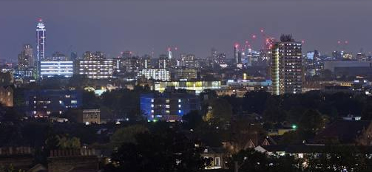



Grew up in central London

Slide 3
Grew up in central London
Completed PhD at University of Southampton- National Oceanography Campus in the UK
Moved to the US in January 2024

Slide 4
Understanding Radiation and Its Applications
Radiation is the emission of particles or energy from a material (chemical element).
Used widely in daily life for healthcare, energy, archaeology, and more.
Notes:
Radiation is very simple,
meaning a material (a chemical
element in this case) that gives
off, or radiates, something as
either particles or energy.
Certain elements, like uranium
only have unstable isotopes,
whilst other elements, like
carbon have isotopes that can
be stable or unstable. Unstable
isotopes (collectively called
radionuclides or radioisotopes)
are radioactive, meaning the
number of neutrons and protons
in their nucleus is unbalanced,
and they want to become stable.
They mostly do this by emitting
alpha, beta and gamma
radiation (other types of
radiation such as neutron
radiation and positron radiation
do exist but are quite rare).

Slide 5
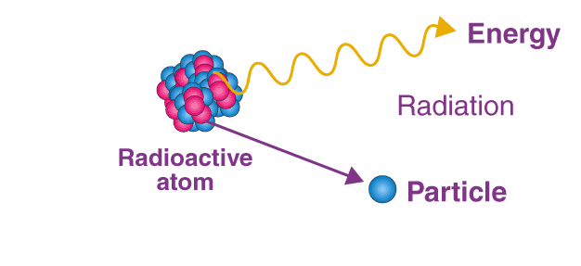
What is Radiation?
Some elements have isotopes that are unstable, called radionuclides or radioisotopes.
Radioisotopes release radiation as they stabilize their nuclei.
Types of radiation: Alpha (α), Beta (β), Gamma (γ).
Notes:
Radiation is very simple,
meaning a material (a chemical
element in this case) that gives
off, or radiates, something as
either particles or energy.
Certain elements, like uranium
only have unstable isotopes,
whilst other elements, like
carbon have isotopes that can
be stable or unstable. Unstable
isotopes (collectively called
radionuclides or radioisotopes)
are radioactive, meaning the
number of neutrons and protons
in their nucleus is unbalanced,
and they want to become stable.
They mostly do this by emitting
alpha, beta and gamma
radiation (other types of
radiation such as neutron
radiation and positron radiation
do exist but are quite rare).

Slide 6
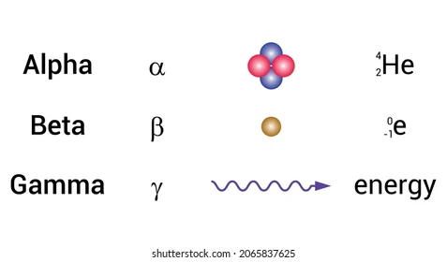
Types of Radiation
Alpha (α) Radiation:
Heavy, slow-moving particles (2 protons + 2 neutrons).
Easily blocked by air or paper.
Dangerous if inhaled or ingested.
Beta (β) Radiation:
Light, fast-moving particles (electrons).
Requires stronger shielding, less dangerous overall.
Gamma (γ) Radiation:
High-energy rays with no mass.
Poorly shielded; dense materials (metals, concrete) are needed for protection.
Notes:
Radiation is very simple,
meaning a material (a chemical
element in this case) that gives
off, or radiates, something as
either particles or energy.
Certain elements, like uranium
only have unstable isotopes,
whilst other elements, like
carbon have isotopes that can
be stable or unstable. Unstable
isotopes (collectively called
radionuclides or radioisotopes)
are radioactive, meaning the
number of neutrons and protons
in their nucleus is unbalanced,
and they want to become stable.
They mostly do this by emitting
alpha, beta and gamma
radiation (other types of
radiation such as neutron
radiation and positron radiation
do exist but are quite rare).

Slide 7
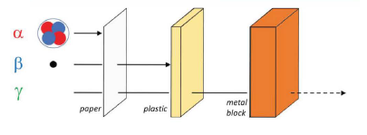
Types of Radiation
Notes:
Radiation is very simple,
meaning a material (a chemical
element in this case) that gives
off, or radiates, something as
either particles or energy.
Certain elements, like uranium
only have unstable isotopes,
whilst other elements, like
carbon have isotopes that can
be stable or unstable. Unstable
isotopes (collectively called
radionuclides or radioisotopes)
are radioactive, meaning the
number of neutrons and protons
in their nucleus is unbalanced,
and they want to become stable.
They mostly do this by emitting
alpha, beta and gamma
radiation (other types of
radiation such as neutron
radiation and positron radiation
do exist but are quite rare).

Slide 8
The Winner Takes It All (Game 1)

Slide 9
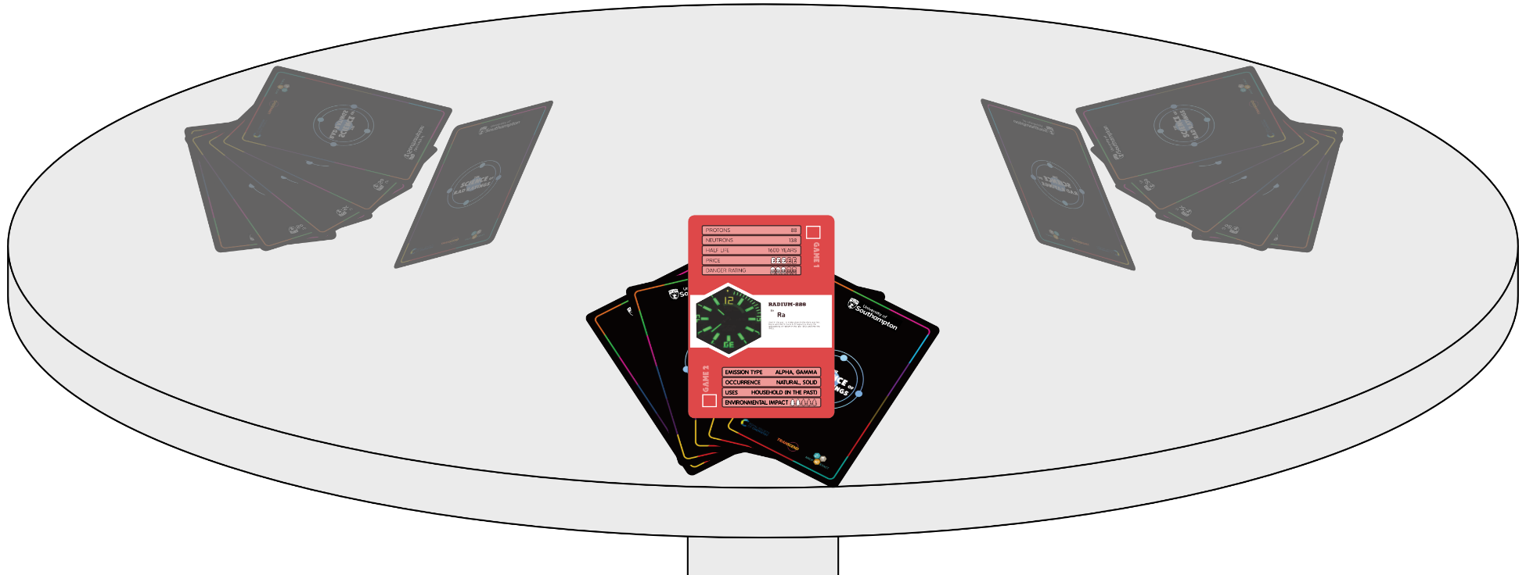
How to play:
In groups of 2-5, shuffle and deal the radionuclide cards face down equally between players.
Players pick up their cards and look at their top cards only.

Slide 10
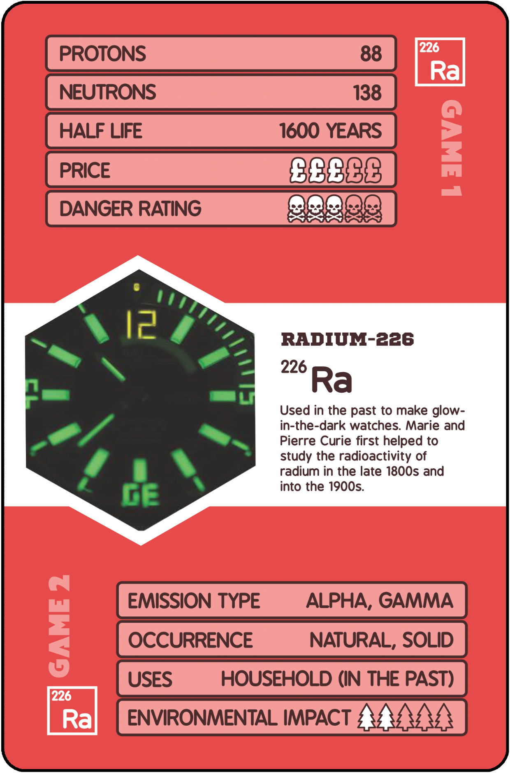
How to play:
Player 1 chooses a question based on the stats at the top of each card (examples are on slide 7) and calls out their best rating.
The other players see if they can beat this rating.

Slide 11
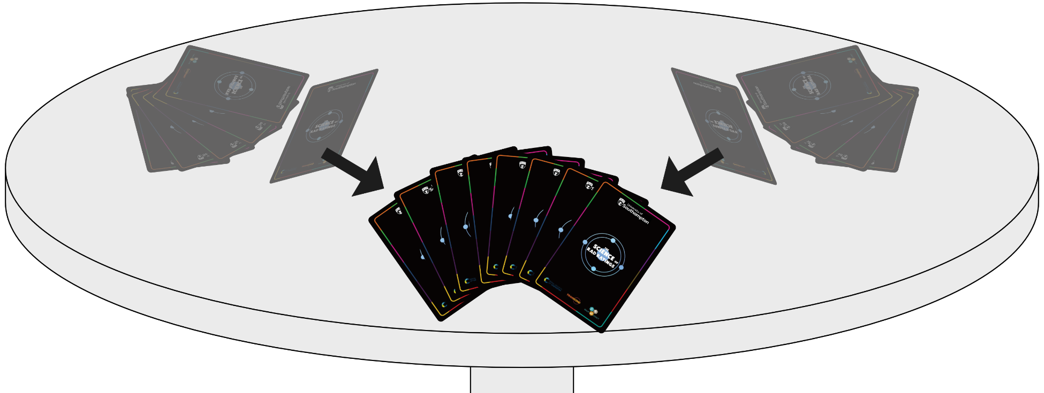
How to play:
The card with the best rating wins all of the top cards and adds them to the base of their pile. If players tie (e.g. they have the same danger rating) then all top cards are put in a new pile and the winner of the next round gets to keep them.

Slide 12
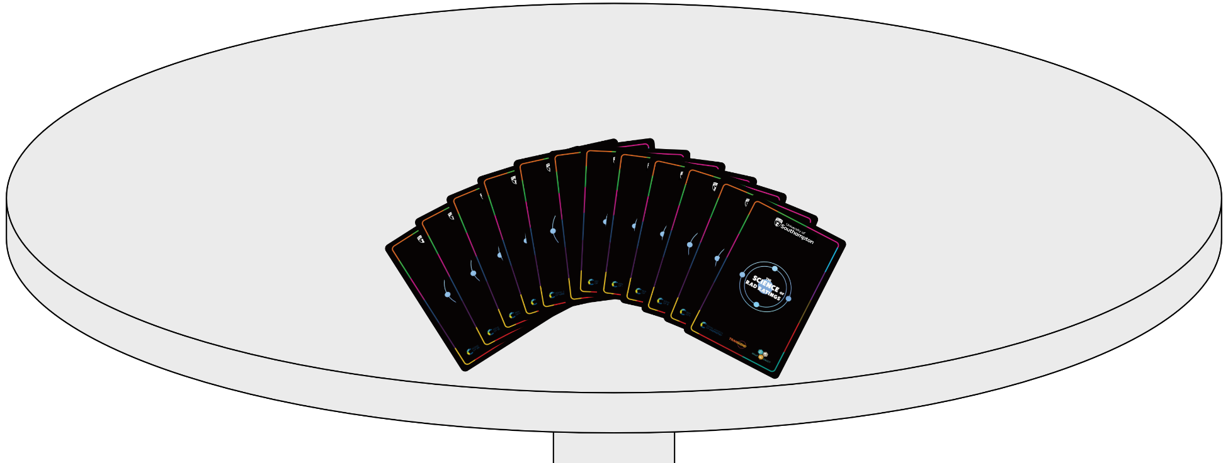
How to play:
The winner of the round chooses the stat for the next round.
The first player to collect all the cards wins!

Slide 13
Example categories: Which radionuclide…
Has the longest half-life?
Has the highest number of protons?
Is the least dangerous?
Has the highest number of neutrons?
Has the shortest half life?
Is the cheapest radionuclide?
Is the most expensive radionuclide?
Is the most dangerous?

Slide 14
Scenarios
(Game 2)

Slide 15
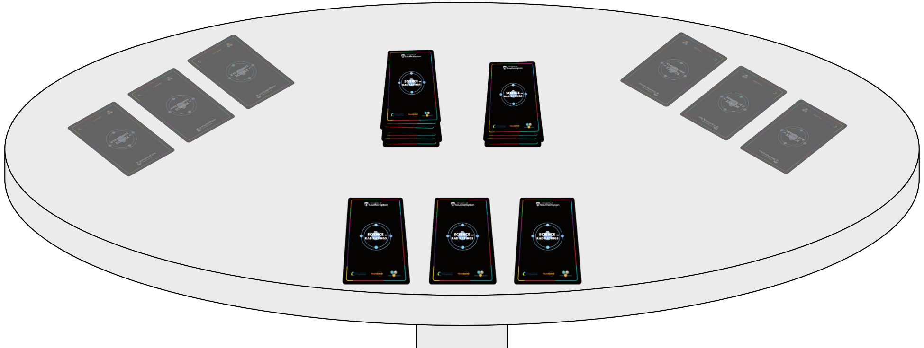
How to play:
In groups of 3-6, shuffle the radionuclide cards and place the deck face down. Each player takes 3 cards but doesn't look at them yet.

Slide 16
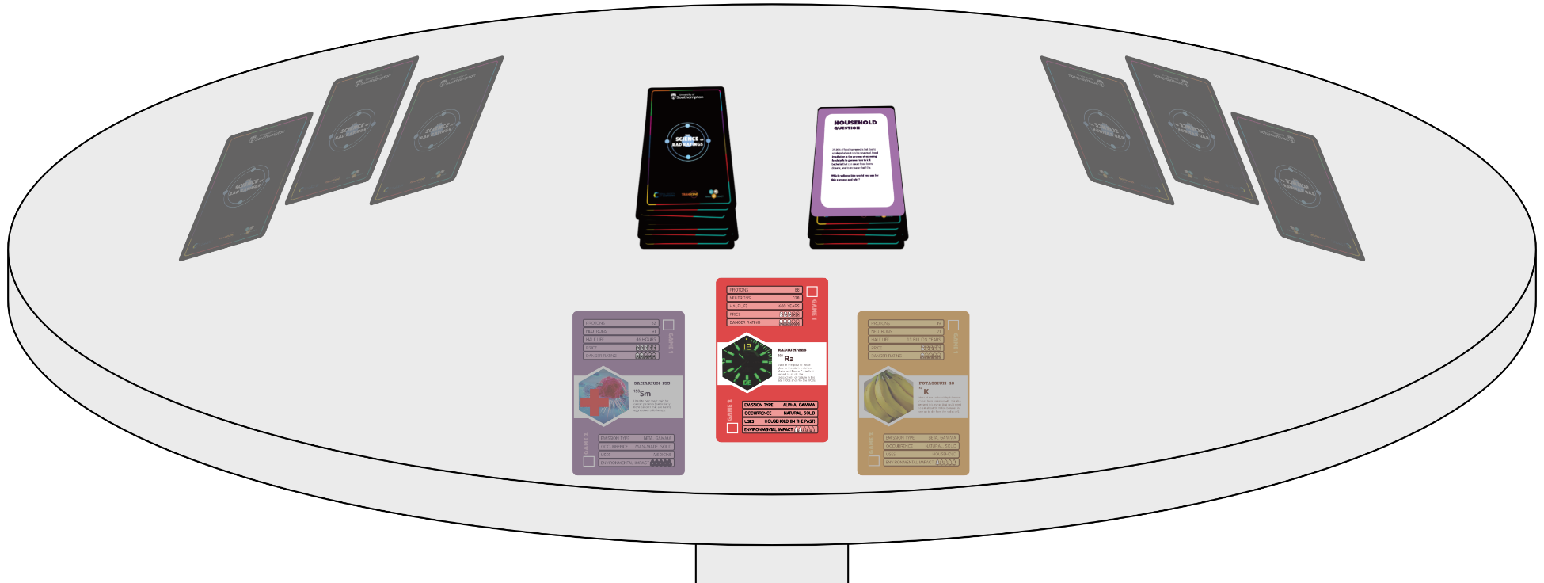
How to play:
Player 1 chooses a scenario card and reads it aloud.
Everyone looks at their own radionuclide cards and picks the isotope that they think is best suited for the job.

Slide 17
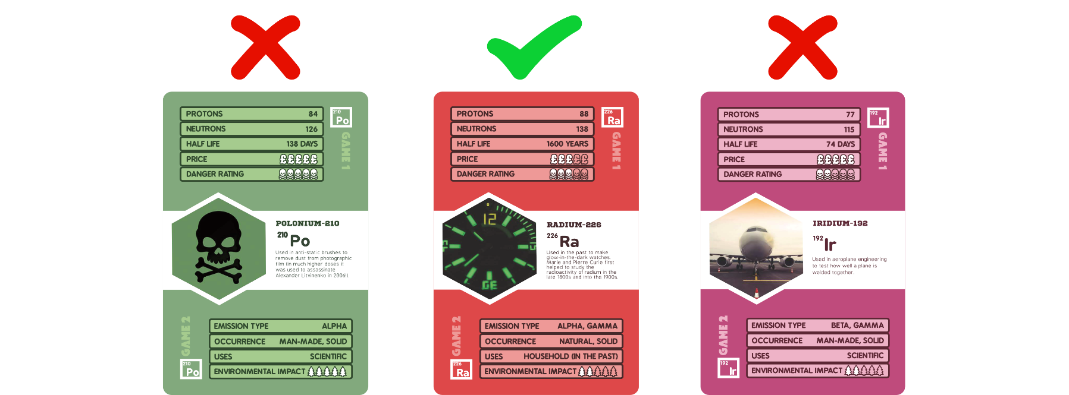
How to play:
Each player presents their chosen card to the group and explains why they think it is the most appropriate radionuclide.
The group votes on which card they think is best for the scenario - you cannot vote for yourself!

Slide 18
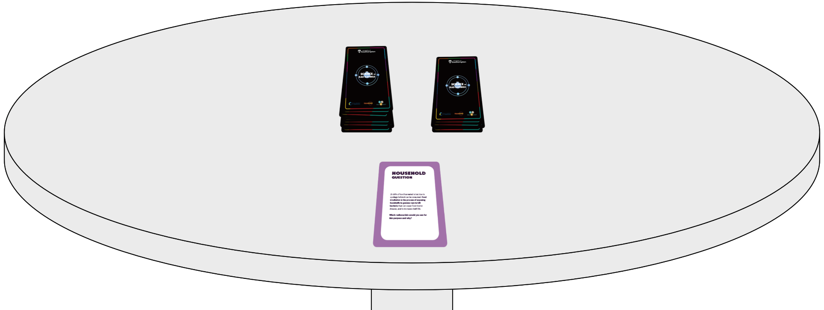
How to play:
The card with the most votes gets put in that player's victory deck and all other cards are shuffled and returned to the bottom of the main deck. If there is a tie, both cards are put in their respective players’ victory decks.

Slide 19
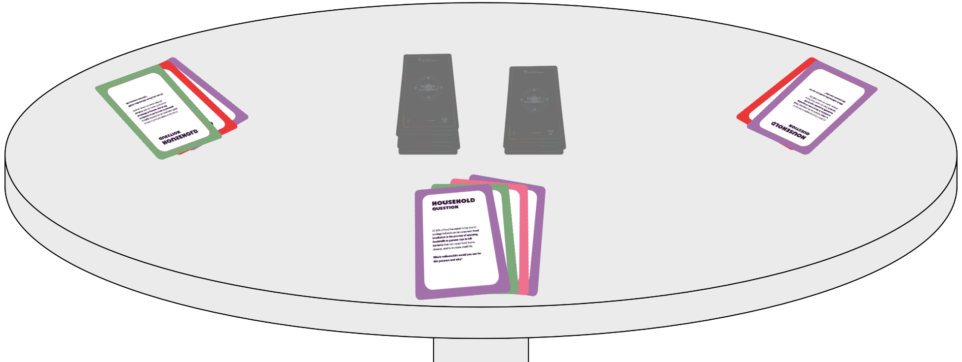
How to play:
Player 2 picks the scenario for round 2, and so on.
The first player to have 4 cards in their victory deck wins!

Slide 20
How to play Game 2 as a whole class:
The class is separated into groups of 5 or 6. Each group gets a pack of radionuclide cards.
Distribute the radionuclide cards evenly between each player in the group.
Each player must pick the most appropriate card in their hand for the application described in the scenarios shown on the following slides.
The answers will be shown after each question. Remember to keep track of your score!
Each player can then return their card to their hand. You can reuse this card in the next round.
The player with the most points at the end, wins!

Slide 21
How to play Game 2 as a whole class:
The class is separated into groups of 5 or 6. Each group gets a pack of radionuclide cards.
Distribute the radionuclide cards evenly between each player in the group.
Each player must pick the most appropriate card in their hand for the application described in the scenarios shown on the following slides.
The answers will be shown after each question. Remember to keep track of your score!
Each player can then return their card to their hand. You can reuse this card in the next round.
The player with the most points at the end, wins!

Slide 22
Household Questions

Slide 23
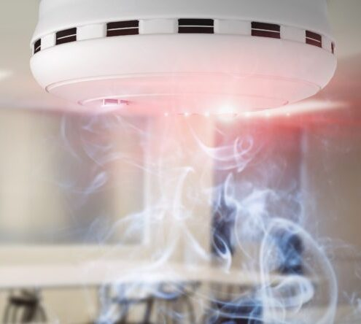
Smoke detectors work by a radionuclide emitting particles which ionise the air. Which is the best radionuclide to use for this purpose and why?

Slide 24



5 points
3 points
1 points
Americium-241
(alpha emitter, solid, suitable half-life; used in real life)
Radium-226
(alpha emitter, solid, suitable half-life)
Thorium-232
(alpha emitter, solid, but long half-life)
Uranium-238
(alpha emitter, solid, but long half-life)
Californium-252
(alpha emitter, solid, but short half-life and expensive)
Notes:
Ideal radionuclides should be – solid alpha emitter, half life of 100s-1000s of years. Uranium-235 and plutonium would not be suitable as it could be gathered up and used in a nuclear weapon(!)

Slide 25
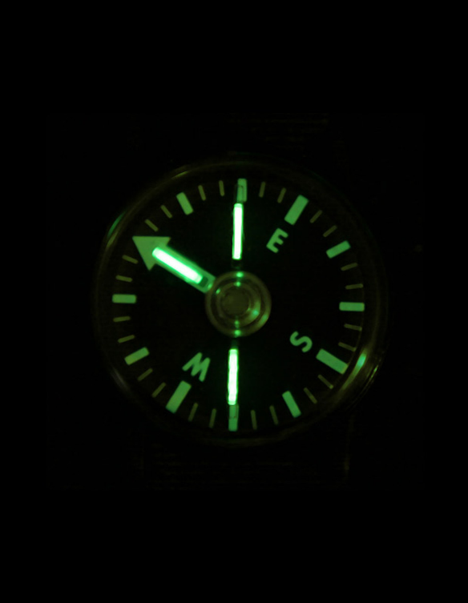
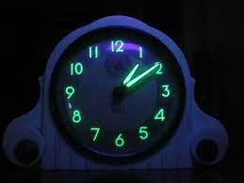
Certain radionuclides release particles during decay, triggering a chemical reaction upon contact with other materials that creates a ‘glow’. This reaction is known as radioluminescence. You are travelling on a research expedition to the Arctic Circle in winter where it is dark 22 hours of the day. You require a compass that can be read easily, which radionuclide would you use for this purpose and why?

Slide 26
5 points
3 points
1 points
Tritium
(beta emitter, solid; used in real life)
Promethium-147
(beta emitter, solid; was used before tritium)
Radium-226
(alpha emitter, solid but long half-life + poisonous; was used before promethium-147)
Potassium-40
(beta emitter, solid, cheap, but long half-life)
Lead-210
(alpha emitter, solid, cheap, suitable half-life, but poisonous)
Nickel-63
(beta emitter, solid, but long half-life)
Notes:
Ideal radionuclides should be – alpha or beta emitter, solid, cheap, half life of 1s-10s of years,

Slide 27


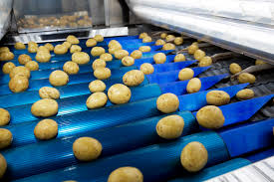
Food irradiation is the process of exposing foodstuffs to gamma rays to kill bacteria that can cause food-borne disease, and to increase shelf-life. Which radionuclide would you use for this purpose and why?

Slide 28
5 points
3 points
1 points
Cobalt-60
(gamma emitter, solid, suitable half-life; used in real life)
Caesium-137
(gamma emitter, solid, suitable half-life; used in real life)
Iron-55
(gamma emitter, solid, but short half-life)
Nickel-63
(gamma emitter, solid, but long half-life)
Iridium-192
(gamma emitter, solid, but expensive)
Promethium-147
(gamma emitter, solid, but expensive)
Notes:
Ideal radionuclides should be – solid, emit gamma radiation, half life of 1s-10s of years, have a low cost and not be poisonous (e.g. lead).

Slide 29
Medicine Questions

Slide 30
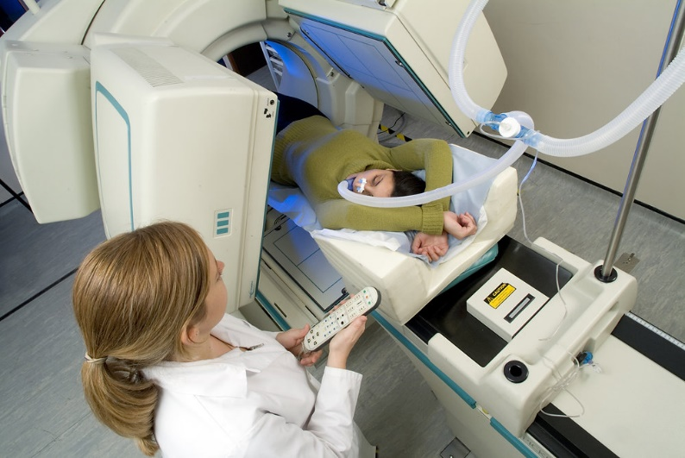
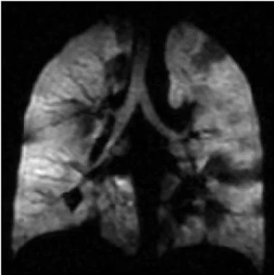
Diagnostic techniques in nuclear medicine use radiopharmaceuticals (or radiotracers) which emit particles or rays from within the body. These tracers are generally short-lived isotopes, and their emissions are detected by the imaging device. A patient needs to have the gas exchange in their lungs investigated, which radionuclide would you use for these investigations and why?

Slide 31
5 points
3 points
1 points
Xenon-133
(gamma emitter, gaseous (can be breathed in), suitable half-life; used in real life
Iodine-131
(gamma emitter, suitable half-life but solid (although it decays to xenon-131 which is a gas))
Technetium-99m
(gamma emitter, suitable half-life, but solid)
Notes:
Ideal radionuclides should be – gas, gamma emitter, half life of hours/days/months, cheap

Slide 32
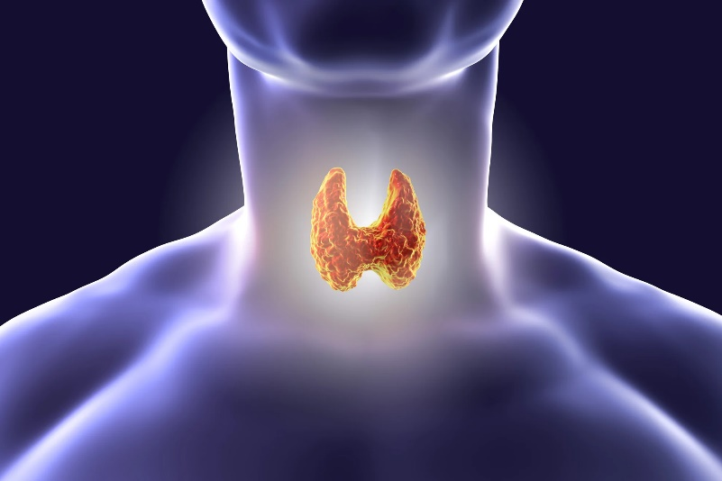
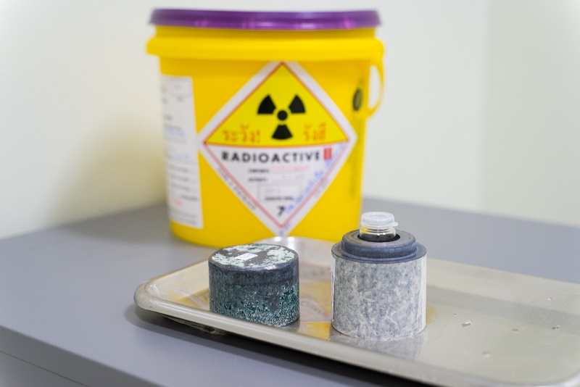
Nuclear medicine is also used for therapeutic purposes. Which radionuclide would you use to treat a cancerous tumour affecting the thyroid gland? Please explain your choice!

Slide 33
5 points
3 points
1 points
Iodine-131
(concentrates in the thyroid, solid, suitable half-life)
Iodine-123
(concentrates in the thyroid, solid, suitable half-life)
Notes:
Ideal radionuclides should be – concentrating in the thyroid, solid or liquid, half life of hours/days/weeks

Slide 34
Nuclear Power Questions

Slide 35
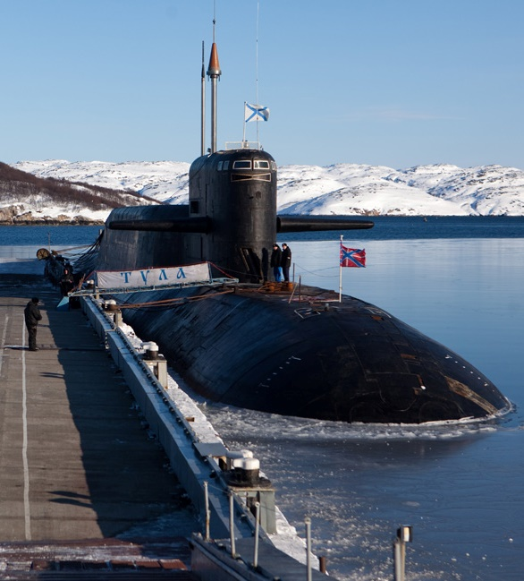

Nuclear power is particularly suitable for vessels which need to be at sea for long periods without refuelling, or for powerful submarine propulsion. Which radionuclide would you chose to power a submarine and why?

Slide 36
5 points
3 points
1 points
Thorium-232
(alpha emitter, solid, suitable half-life; used in real life)
Uranium-235
(alpha emitter, solid, suitable half-life; used in real life)
Plutonium-238
(alpha emitter, solid, suitable half-life, but expensive compared to Thorium and Uranium)
Uranium-238
(alpha emitter, solid, suitable half-life, but does not burn efficiently in nuclear reactors)
Americium-241
(alpha emitter, solid, suitable half-life but expensive compared to thorium and uranium)
Notes:
Ideal radionuclides should be – solid, half life of many years, cheap, large relative atomic mass

Slide 37


Radioisotope Thermoelectric Generators (RTGs) have been used as an electricity source in spacecraft since 1961 due to their high decay heat and short range of particle emissions. You are in charge of selecting an appropriate radionuclide to power a 50-year satellite Mars mission, which radionuclide do you choose to power your satellite and why?

Slide 38
5 points
3 points
1 points
Plutonium-239
(alpha emitter, solid, suitable half-life; used in real life)
Americium-241
(alpha emitter, solid, but long half-life (so lots would be needed))
Notes:
Ideal radionuclides should be – solid, pure alpha emitter (to avoid irradiating other satellite components), half life of years (but <100 years), cheap, natural

Slide 39
Science Questions

Slide 40



Efficient use of fertilisers is a concern to both developing and developed countries. Fertilisers 'labelled' with a particular isotope provides a means of finding out how much is taken up by the plant and how much is lost into the environment. Which radionuclide would you use for this purpose and why?

Slide 41
5 points
3 points
1 points
Phosphorus-32
(beta emitter, solid, suitable half-life, low environmental impact; stable phosphorus is an essential plant nutrient and so phosphorus-32 is used in real life)
Calcium-47
(beta + gamma emitter, solid, suitable half-life, low danger and environmental impact, stale calcium is a plant nutrient, but calcium-47 is man made)
Potassium-40
(beta + gamma emitter, solid, cheap, natural, low danger, low environmental impact, stable potassium is a plant nutrient, but potassium-40 has a very long half-life)
Notes:
Ideal radionuclides should be – solid or liquid, beta emitter, half life of days/weeks/months, cheap, natural, low danger and low environmental impact

Slide 42
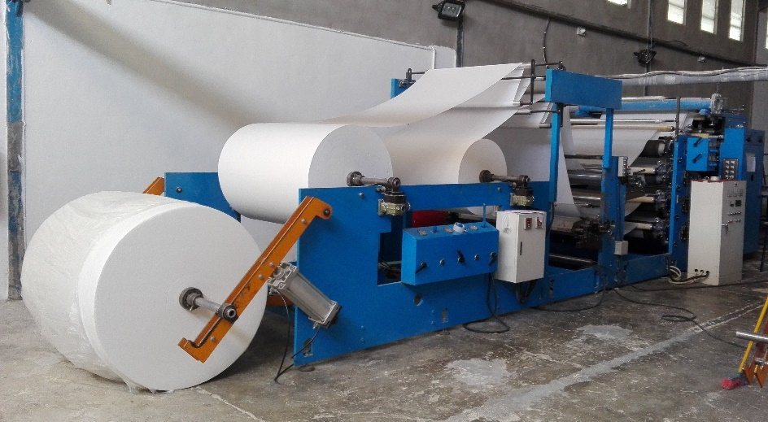
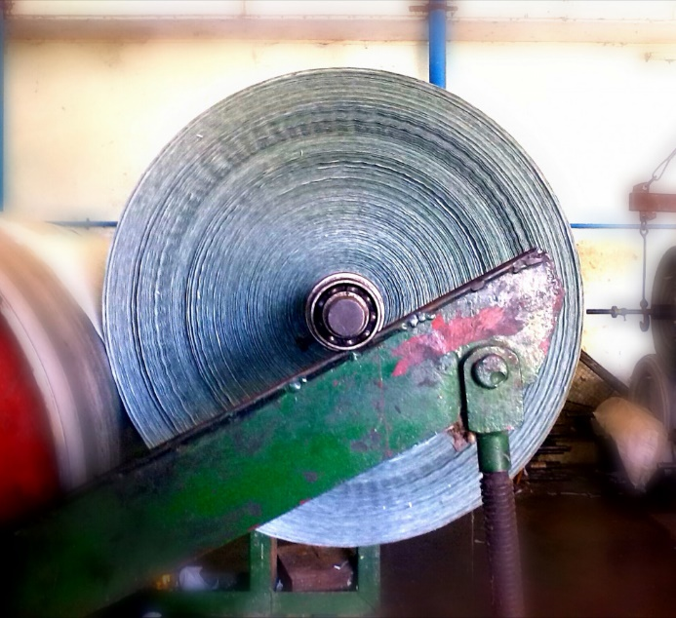
Radioisotopes can be used to accurately measure the thickness of many different sheet materials. They measure the amount of radiation from a source which has been absorbed in materials. Which radionuclide would you use to measure the thickness of an extruded metal pipe, why did you choose this radionuclide?

Slide 43
5 points
3 points
1 points
Iridium-192
(beta emitter, solid, suitable half-life; used in real life)
Cobalt-60
(beta emitter, solid, suitable half-life, cheap, but high danger rating)
Iron-55
(beta emitter, solid, suitable half-life, cheap)
Nickel-63
(beta emitter, solid, cheap, but long half-life)
Notes:
Ideal radionuclides should be – solid, beta +/- gamma emitter, low environmental impact and danger, half life of months/years and cheap

Slide 44
Bonus Round!

Slide 45
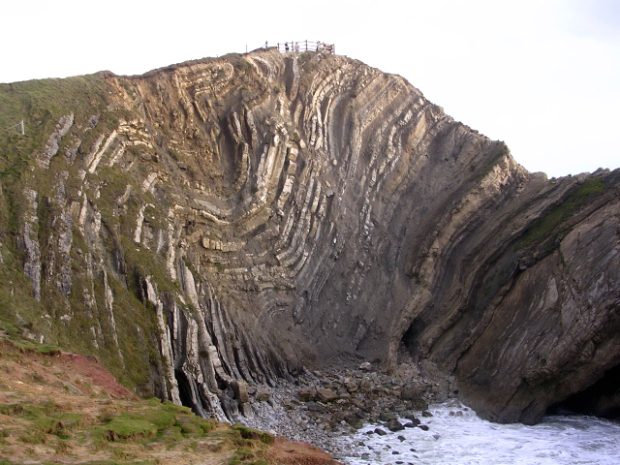
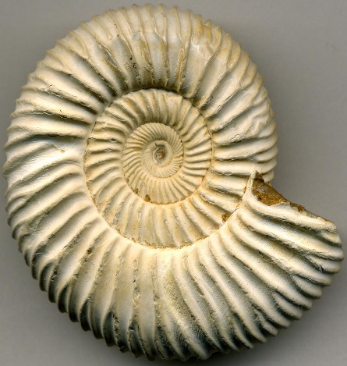
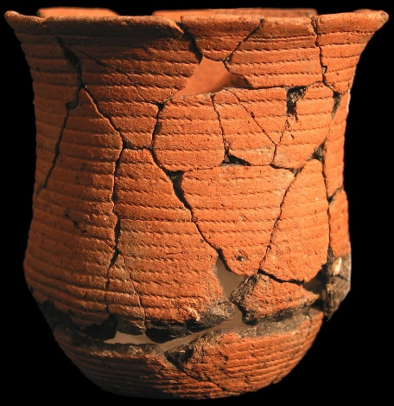
Analysing naturally-occurring radioisotopes is important for determining the age of rocks and other materials that are of interest to geologists, anthropologists, and archaeologists, among others. A historian thinks the wooden beams in an old house were made in the early Tudor period (about 500 years ago). Which radionuclide would you use to check the age of the wood, and therefore the age of the house?

Slide 46
5 points
3 points
1 points
Carbon-14
(solid, suitable half-life, abundant in wood; used in real life)
Tritium
(solid, suitable half-life, found in wood although it is rare, so carbon-14 gives a more reliable age)
Caesium-137
(solid but not found in wood older than ~1950; better for dating sediments)
Lead-210
(solid but not found in wood and half life is too short; better for dating sediments)
Notes:
Ideal radionuclides should be – solid, beta +/- gamma emitter, half life of years, natural, abundant in wood

Slide 47
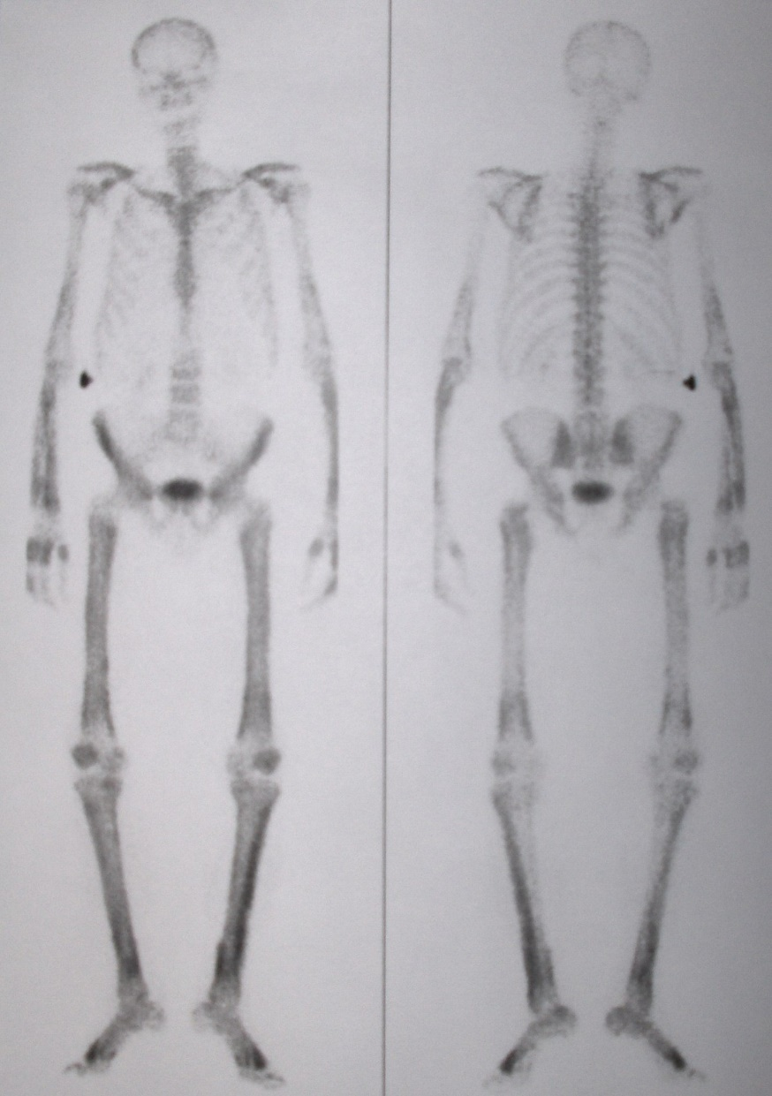
With any therapeutic procedure, the aim is to confine the radiation to well-defined target volumes of the patient. There are several radionuclides that are used for the relief of cancer-induced bone pain. Which radionuclides would you use to target cancerous growths in the bone and why?

Slide 48
5 points
3 points
1 points
Calcium-47
(beta emitter, solid, suitable half-life, easily absorbed by bone; used in real life)
Samarium-153
(beta emitter, solid, suitable half-life)
Yttrium-90
(beta emitter, solid, easily absorbed by bone, but has a short half-life, better suited for treating liver cancer)
Strontium-90
(beta emitter, solid, cheap, easily absorbed by bone, but has a high environmental impact)
Caesium-137
(beta emitter, solid, but long half-life and not easily absorbed by bone)
Notes:
Ideal radionuclides should be – beta +/- gamma emitter, can be absorbed by bone, solid or liquid, half life of hours/days/weeks, cheap and natural

Slide 49
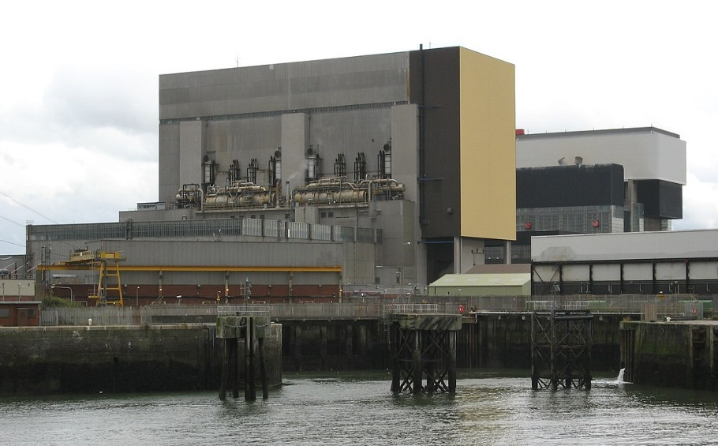
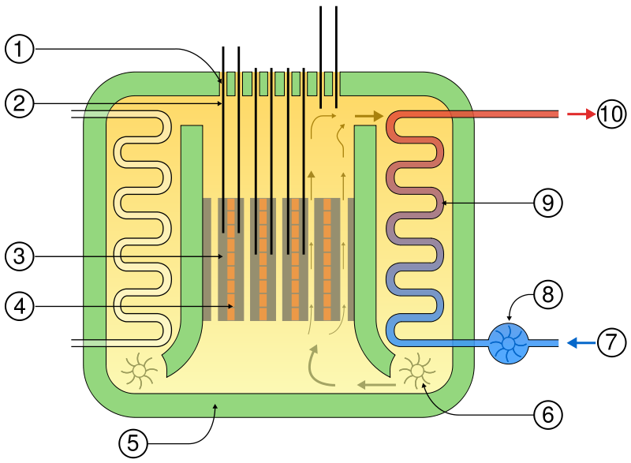
Advanced Gas-cooled Reactors (AGRs) are the second generation of British gas-cooled reactors. These reactors, like other nuclear technology, use the energy released by splitting atoms of certain elements. Which is the best radionuclide to use as a fuel for an AGR and why?

Slide 50
5 points
3 points
1 points
Thorium-232
(alpha emitter, solid, suitable half-life; used in real life)
Uranium-235
(alpha emitter, solid, suitable half-life; used in real life)
Plutonium-238
(alpha emitter, solid, suitable half-life, but expensive compared to thorium and uranium)
Uranium-238
(alpha emitter, solid, suitable half-life, but does not burn efficiently in nuclear reactors)
Americium-241
(alpha emitter, solid, suitable half-life but expensive compared to thorium and uranium)
Notes:
Ideal radionuclides should be – solid, half life of many years, cheap, large relative atomic mass

