Slide 1
Introduction to Search Theory and its Application
Tom Russo
ESCAPE 2015
19 April
Management Track

Slide 2
Welcome
Term | Statistic | Search
Count | n | 12,900
First quartile | 25% | 1:08
Median | 50% | 3:10
Third quartile | 75% | 8:45
Half-Day | 81% | 12:00
Day | 93% | 24:00
Two Σ | 95.4% | 33:20
Three Σ | 99.7% | 576:00
Average | X | 16:20
Notes:
93% of searches are concluded in the first 24 hours. 95% in less than 33 hours.
Old school classes taught formal search planning as if it were the norm. WRONG
Too much theory impedes early effort.
BUT: 5% of searches go long enough that planning is critical.
Must know formal planning methods.
Search theory!

Slide 3
Overview
Origins of search theory
Objective POD
POS, Resource Allocation, Planning
Operations – briefing and debriefing
Where do we go from here?
Notes:
Class objectives:
Introduce mathematical theory of search
develop basic understanding of objective POD and input quantities
Develop basic concept of optimal search
Describe ways in which current search operations practice should be modified to incorporate search theory properly.

Slide 4
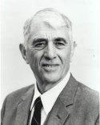
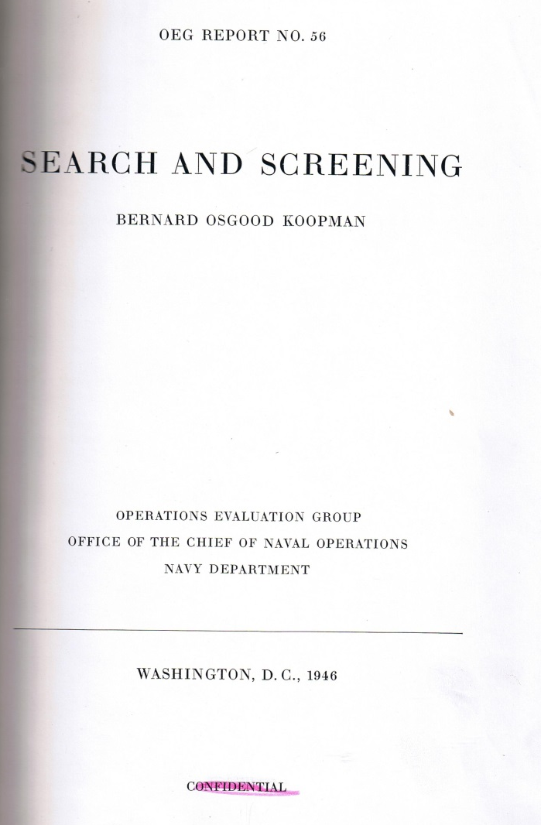

Origin of Search Theory
Bernard Koopman
1946 WW II research to sink subs
Operations research
Detection index
Objective POD
Resource allocation
Declassified 1958, revised and extended 1980
Available from MORS
Classified
http://www.mors.org/Publications/Books
Notes:
Operations research: field of mathematics applying advanced mathematical method to make better decisions. Example from WWII: aerial delivered depth charges – 100 feet → 25 ft, kill rate 1% → 7%.
Objective POD: as distinct from “subjective” (i.e. guessed!)
Provides guidance for optimally assigning resources
MORS = “Military Operations Research Society”
Resources limited – use operations research/search theory to determine how to use limited resource to get best result as fast as possible.

Slide 5
Search theory in Land SAR
Most land SAR classes do not teach search theory properly.
“A scientific theory should be as simple as possible, and no simpler.” – A. Einstein
“Please forget everything you have learned in school, for you haven't really learned it. Please keep in mind the corresponding parts of your school curriculum, for you haven't actually forgotten them.” – E. Landau, Foundations of Analysis
Notes:
Search theory requires advanced math to create and develop into coherent logical system. But does not require advanced math and mathematicians to USE in practical search. By 1970s, search theory had been developed into manuals and procedures to be used by planners who were not mathematicians.
People familiar with these manuals and procedures introduced isolated concepts into land SAR without all the linking concepts that keep it coherent, useful, and CORRECT. This led to an incomplete system that was then developed by people who were NOT experts in search theory (e.g. mathematicians).
Oversimplified. Very useful concepts lost, unnecessary procedures introduced, etc.

Slide 6
Why Search Theory?
“Searching is by its very nature a probabilistic process in which there is no guarantee of either success or failure. However, a carefully planned search using the right tools and concepts is significantly more likely to succeed and, of equal importance when lives are at stake, succeed sooner.”
Bernard Koopman
Notes:
Koopman is founder of the field of search theory. This quotation is meant to explain exactly why we're bothering to learn search theory: plan a search with the right tools, because with the right tools you can succeed sooner, and save more lives.
“'Everyday' reasoning is unreliable” – Don Ferguson's talk

Slide 7
What is “Success” in Search?
Finding the thing you're looking for!
“Probability of Success” (POS).
Fundamental relation:
Must look in the right place, must actually make a detection.
POC and POD: Subject-specific!
Notes:
Success is finding subject. POS is probability of finding subject. Therefore POC must be the probabilities that the subject is contained in the search area, and POD must be the probability that the search method employed would find THE SUBJECT if he/she/it were there.
NOT “subject or clues,” not “clues,” not “balls of white socks,” or any other combination. Looking for clues is a tactic and is an important part of searching, but you do not PLAN based on probabilities of clues being out there or clues being found.

Slide 8
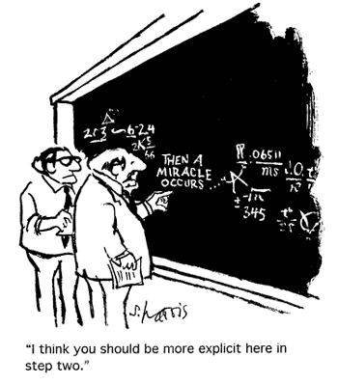
A balancing act...
Notes:
This class is too short to go into gory detail of every topic. Had to pick and choose. In some cases skip over math that is not enlightening, in others go into more detail in hopes of giving a deeper sense of what's underneath the hood.
At this point, read the room (or just ask) and see if there are enough nerds to justify having side remarks on whiteboard/flipcharts.

Slide 9
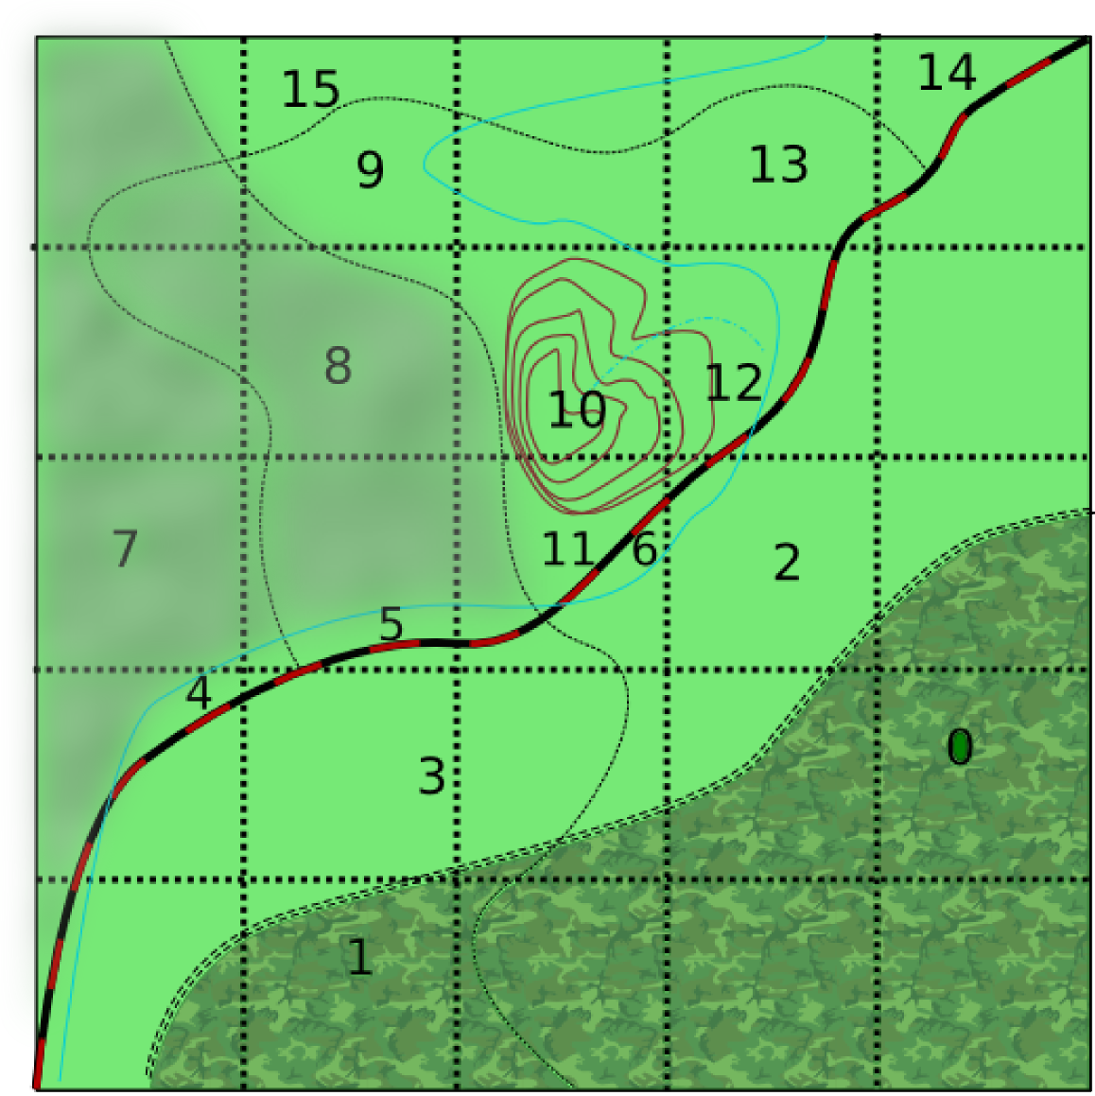

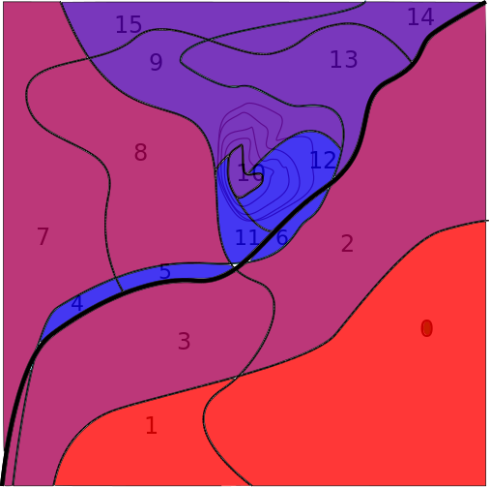


POC – Probability of Containment
Region | POC
0 | 0.15
1 | 0.15
2 | 0.10
3 | 0.10
4 | 0.01
5 | 0.01
6 | 0.01
7 | 0.10
8 | 0.10
9 | 0.05
10 | 0.05
11 | 0.01
12 | 0.01
13 | 0.05
14 | 0.05
15 | 0.05
Notes:
Without any information, no justification for considering any part of search area more likely than any other. In that case the only thing to do is to search whole area as uniformly as can.
Information like features, terrain, subject profile, historical data provides means to distinguish parts of the search area from each other. Now some parts can be said to be more likely than others.
Level of confidence that subject is contained in any sub region of the search area is the POC for that area.
Obtaining a usable POC map can be a complex art, and is appropriate topic for ANOTHER class. For now, just assume that we have SOMEHOW obtained a number for each subregion that we will call POC. Static here, dynamic in life.
SUBJECT: Mr. Kobayashi Maru

Slide 10
Obtaining POC
Lost person behavior
Historical data
Bayesian networks
Consensus
Notes:
Lost person behavior stats can help, but are NOT enough. Data quality issues, small sample size, overselling. But is a good first bit of data to get started.
Local historical data even more valuable, need to have captured, archived, and accessible.
Bayesian networks: way of relating connected random variables by probability, and method of updating relationships as “evidence” is accumulated.

Slide 11
Probability of Detection
Conditional probability
“Detectability”
Method/effort
Objective POD
Quantify “detectability” and effort
Notes:
For conditional probability, use “probability that I would detect an elephant in room 4 if there were one there.” Very distinct from “probability that I will find an elephant in room 4.”

Slide 12
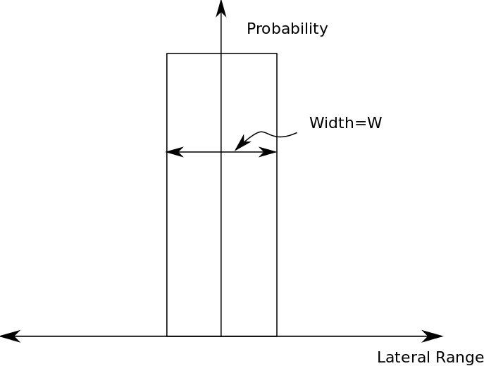
Quantifying Detectability:
The definite detector
Perfect detector
Width W
Detection profile
“Lateral Range Curve”
POD?
100%
Sensor Track
Lateral Range
search object
Notes:
Lateral range: distance from sensor's path at its closest approach.
Lateral range curve is not the probability of detecting the object when it is that far from the sensor – it is the cumulative probability of detection from all detection opportunities along the entire sensor path.
Knowing the lateral range curve and how the sensor is applied to the search area allows computation of POD.
We now go through two very different applications of the same detector to a given search area, and get two very different results.

Slide 13
Parallel Track Line Search – Definite Detector
Length=l
W
Search Area=A = h´l
Height=h
W´h
Total track length = L
L also called “Effort” --- related to time spent searching
Area seen by detector = W´L: Area Swept, Z
Area Swept/Search Area = Z/A = “Coverage” = C
Notes:
Light blue = 0% detection
Dark blue = 100% detection
For definite detector, POD exactly equal to coverage

Slide 14
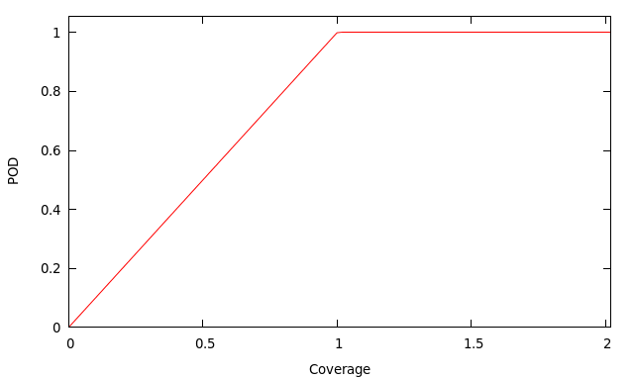
POD vs. Coverage: Definite Detector
POD = Coverage until dark blue fills area, 100% after that. Overlap waste of effort.
Best case possible, perfect detector, perfect pattern
All other detectors require detailed analysis for POD vs Coverage: detection profile, search pattern, etc.
Notes:
Perfect detector, perfect parallel track search: best possible POD vs. Coverage.
Random search: Drop detector at random in search area. Area swept is just sum of areas of circles around detector of diameter W. Overlap counts in coverage, but doesn't improve POD. Can compute average POD assuming detector can land anywhere. Koopman did it, called it “Law of Random Search.”

Slide 15
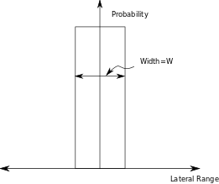
Useful consequences
Uniform distribution, density “r” objects/unit area.
All objects inside range found
N = r´W´L = r´W´v´t objects found
Rearrange:
W is also area under detection profile
1.0
Notes:
Random placement of these objects, not regular --- but not “random” in sense of just tossing them around. Uniform distribution: each square unit of area has equal number of objects in it. 6400 per square mile = 10 per acre, etc. any 1 acre has 10 in it.

Slide 16
Random Search
Total Track Length=L
Takeaway message: random search POD = 1 – exp(-C) (POD = 1-exp(-WL/A))
Divide into “n” segments
Notes:
n independent segments
POD is probability of finding *somewhere*
Either find somewhere, or miss everywhere. Sum of the two probabilities must be one.
POD = 1 – probability of missing everywhere
because each segment independent, prob of missing everywhere is product of probability of missing in each segment.

Slide 17
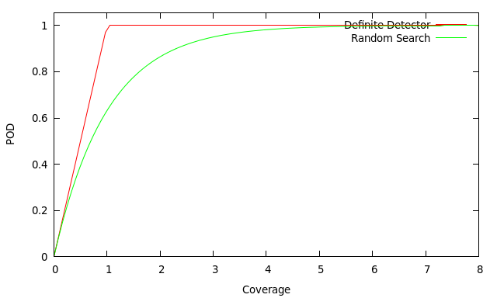
POD vs. Coverage: Random Search
Random search “worst case.”
Diminishing returns: double coverage not double payoff.
Notes:
POD(C=1) = 63%
POD(C=2) = 86%
POD(C=4) = 98%

Slide 18
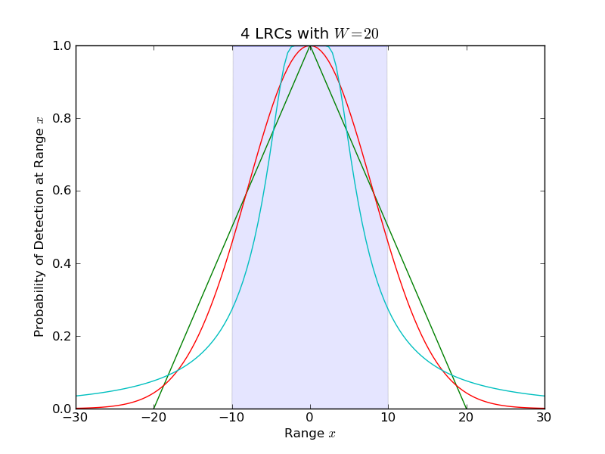
Quantifying Detectability: real detector
Real detection profiles may be complicated
Define “effective sweep width”: Detection index
W=area under curve
Coverage vs. POD
Random search law
Finding W?
Notes:
If define effective sweep width as <n/t>/(rho*v) then a consequence of this definition is that W must also be the area under the lateral range curve.
Coverage is still computed as WL/A, but POD vs. Coverage is highly dependent on shape of lateral range curve and pattern of search.
BUT: random influences (“Human fallibility,” as Koopman says, avoiding obstructions, terrain variations, etc.) always present, and using the random search law is a good estimator. So we can use the W for a real detector in a not-completely-random search in the random search law POD=1-exp(-C).
But we don't have an easy way of getting W.

Slide 19
More Useful Consequences
Average number objects detected beyond W = Average number objects missed within W
Provides means of measuring W without knowing detection profile!
Notes:
This property is extremely useful and is a direct mathematical consequence of the definition of the sweep width as <n/t>/(rho*v) and the definition of the lateral range curve. (easy to show with a little calculus).
To use this, we do exactly what the figure shows: populate a search area with a uniform random distribution of search targets, run the sensor (searcher) through the area along a track, and record the detections and failed detections. The distance at which failed detections at that distance or closer is equal to detections at that distance or further is the lateral range equal to half the sweep width.

Slide 20
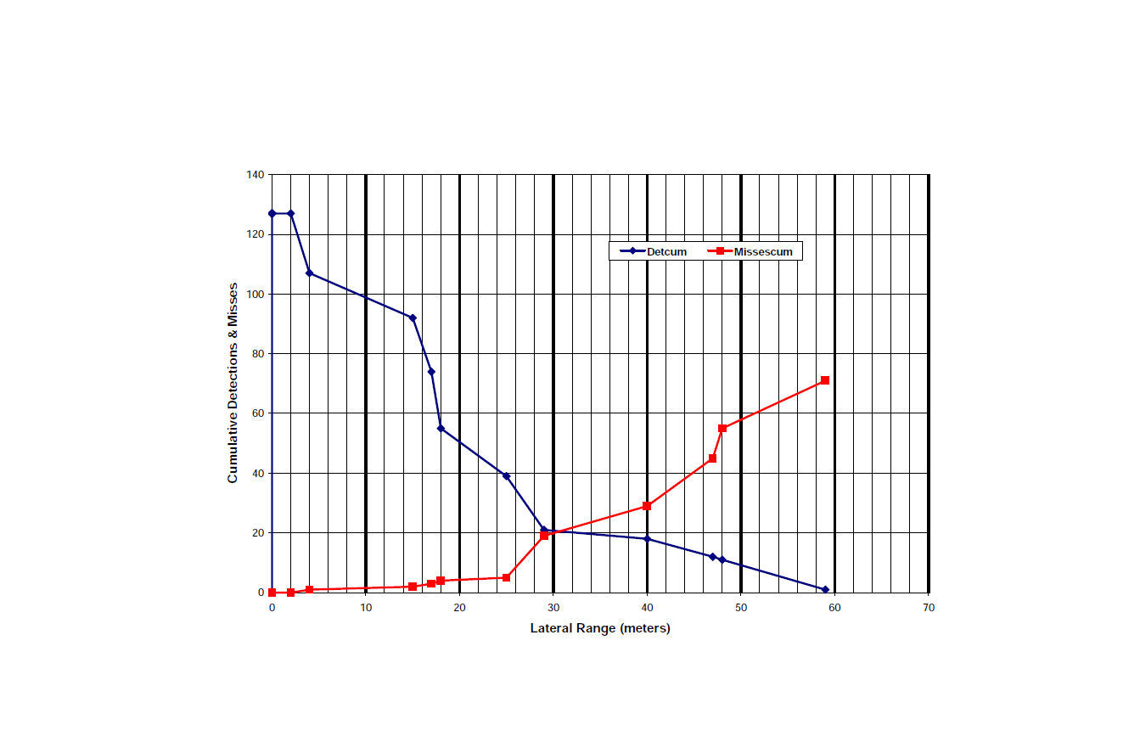
Measuring W
ESCAPE 2004 data, Ruidoso, Lincoln NF
Search object = manikin, blue coveralls
W = 60 meters
Enormous effort! Repeat for every object, place, environment?
Notes:
There have been 10 experiments like this done throughout the country, each provides a set of sweep widths for specific target types in that ecoregion/season/weather/lighting/etc.
it takes serious set-up and data analysis, but can be repeated if one knows the procedure.
I tried to get this done at this ESCAPE (an ecoregion not yet studied), but conference location is not amenable – couldn't guarantee enough participation given travel time to suitable area.
Experimenters are willing to come do it again, but have to be able to justify travel with enough participants.

Slide 21
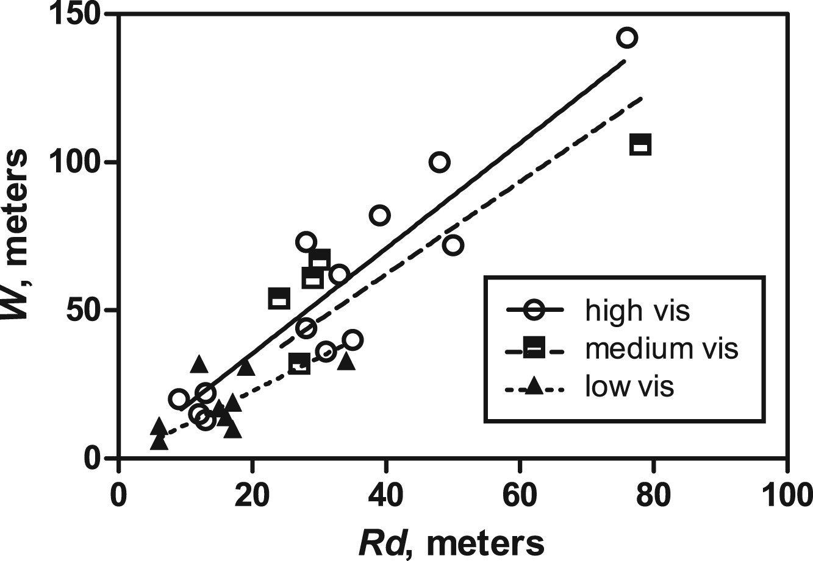
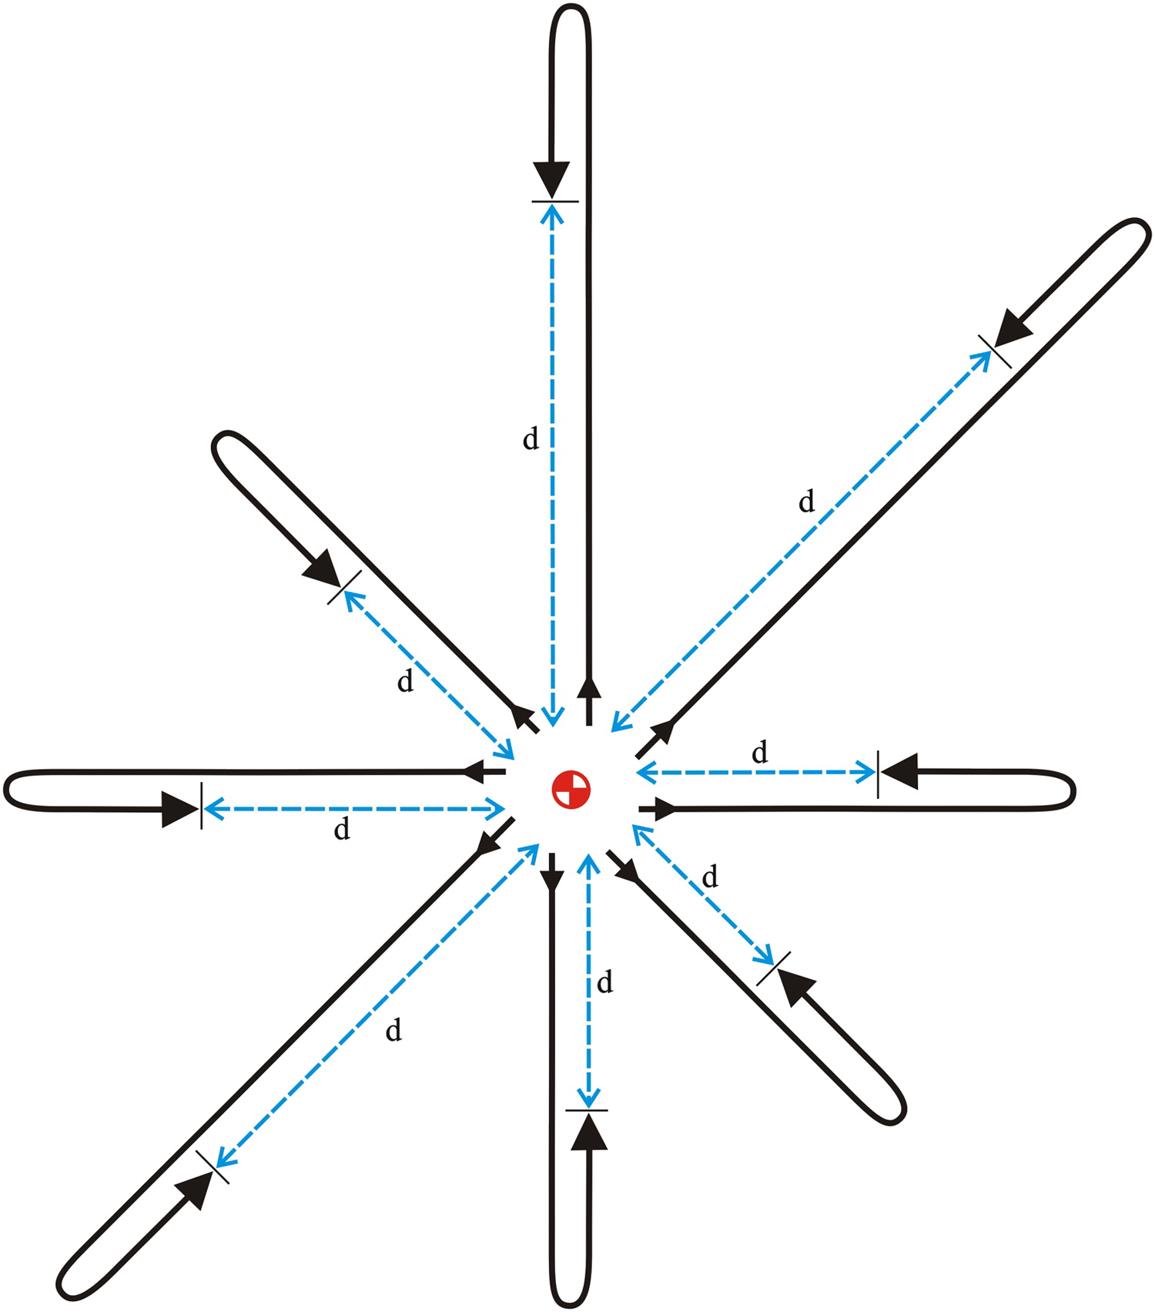

Estimating W - Shortcut
Wilderness & Environmental Medicine, 25, 132-142 (2014)
http://www.wemjournal.org/article/S1080-6032%2813%2900266-4/abstract
Operationally:
Notes:
In process of taking sweep width data, experimenters also computed AMDR and Rd, so could compare to W. Found correlation that is statistically significant. Published last year.
QR code takes to full text of article. Figures taken from article.

Slide 22
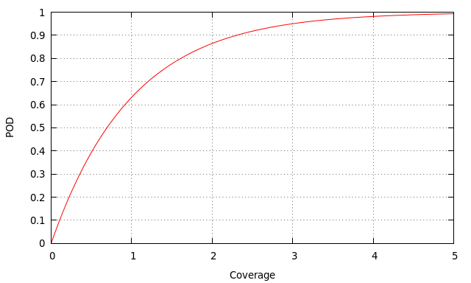
Recap
W from sweep width experiments, or field Rd measurements.
L from searcher total track – GPS, time of travel, etc.
C = W´L/A
POD = 1 – exp(-C)
So what?

Slide 23
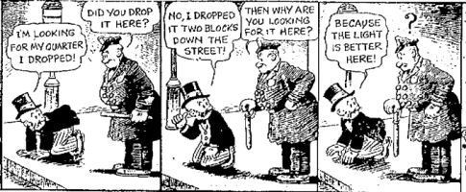
High POD
Notes:
Knowing POD only one tiny piece of puzzle
Need to focus effort where payoff (find) is most likely.
For simple problems, choosing where to search is obvious
When POCs and areas vary widely, or when sweep width and search speed vary between areas, allocating resources optimally is not easy.
POS, POC, and objective POD are the tools we can use to make better allocation decisions.

Slide 24
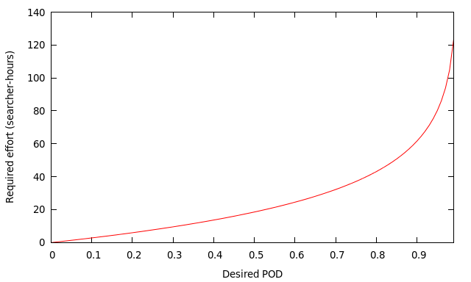
POD ain't free
POD requires effort
A=1 sq-mile
v=1mph
W=60 meters
Available effort is limiting factor
Notes:
One cannot simply dictate what POD one wants --- one has to “pay” for it with searcher effort.
If don't have enough effort available to search whole area, have to allocate available effort to best effect.
This is the core problem that search theory is designed to help with.

Slide 25
Care about POS
High Overall POS (OPOS) is key
Objective POD: Formula relates effort to payoff
Overall POS: Sum of region POS values
Distribute available effort to maximize OPOS each operational period
Higher probability of success, higher probability of success SOONER, lives may be at stake.
Notes:
POD isn't the goal, POS is the goal.
Since we have a way of getting POD from effort allocation, can determine how much effort a given POD requires, or what POD a given effort yields.
Can evaluate a plan before doing it and find what its predicted POS would be.
Can compare OPOS of different plans, choose the one with highest
Operational constraints ALWAYS trump theoretical values, but theory provides measure of how much you're giving up when bowing to reality.

Slide 26
Impact of searching
Searching area reduces POC
New POCs after wave of search
“Posterior Probability”
Notes:
Can't talk about how to allocate without understanding what searching an area means to later planning.
Search without finding means one of two things: you missed the subject, or the subject isn't there.
POC is “prior” probability, state of belief where subject is.
After unsuccessful search, your confidence that subject is there must go down.
Bayesian probability tells us how to adjust our state of belief in face of evidence (negative result).
1-POD is probability of missing.
POC*(1-POD) is probability that detection didn't happen because of overlooking, even though subject there. i.e. probability subject is still there.

Slide 27
Example calculation
Search region 8 with 40
searcher-hours.
Assume W = 197ft (60m)
Assume v = 1.5 mph
A = 2.52 sq. mi
POC = 0.10
THEN:
Coverage: 0.89
POD = 59% = 0.59
POS = 0.059
New POC = 0.041
Notes:
These POD choices in these areas were randomly chosen, just to demonstrate use of formula.
When discussing, remember to point out that in order to compute coverage, have to convert W from feet into miles. 197 feet is 197/5280 miles = 0.0373 miles
Wv = .0373*1.5 = 0.05596 sq-mi/hour
Wvt = 0.0373*1.5*40 = 2.2386 sq-mi
Wvt/A = 2.2386/2.52 = 0.888 (unitless)

Slide 28
Value of adjusted POC and POS
Before doing search: projected payoff of search in that area
After doing search: how much probability is left, projected value of searching there again

Slide 29
Resource Allocation
Region | POC
0 | 0.15
1 | 0.15
2 | 0.10
3 | 0.10
4 | 0.01
5 | 0.01
6 | 0.01
7 | 0.10
8 | 0.10
9 | 0.05
10 | 0.05
11 | 0.01
12 | 0.01
13 | 0.05
14 | 0.05
15 | 0.05
You have 200 searcher-hours. How would you allocate them?
Notes:
Concepts of objective POD, POS, initial POC and Bayesian-adjusted POC are fundamentally useful for purposes of resource allocation decision-making. Without them it is difficult to choose an allocation that maximizes probability of success – the best measure of the quality of a plan.
200 searcher hours: 20 searchers available for 10 hours.
Some texts will tell you to search the highest POC areas first, but is that right?

Slide 30
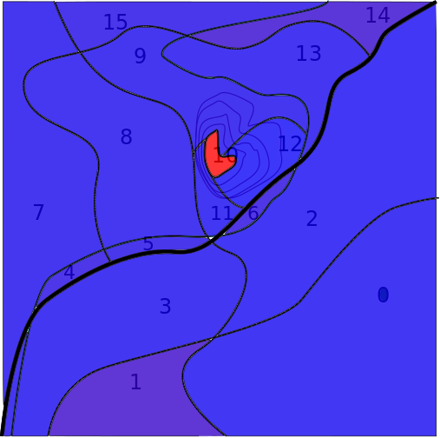
Area matters
Region | POC | Area | Pden
0 | 0.15 | 5.22 | 0.029
1 | 0.15 | 1.44 | 0.104
2 | 0.10 | 3.95 | 0.025
3 | 0.10 | 3.01 | 0.033
4 | 0.01 | .18 | 0.056
5 | 0.01 | .21 | 0.048
6 | 0.01 | .16 | 0.063
7 | 0.10 | 2.87 | 0.035
8 | 0.10 | 2.52 | 0.040
9 | 0.05 | 1.35 | 0.037
10 | 0.05 | .1 | 0.5
11 | 0.01 | .36 | 0.028
12 | 0.01 | .66 | 0.015
13 | 0.05 | 1.41 | 0.035
14 | 0.05 | .55 | 0.091
15 | 0.05 | 1.01 | 0.050
Areas in Square Miles

Slide 31
So now whaddya think?
Region | POC | Area | Pden | W | v
0 | 0.15 | 5.22 | 0.029 | 75 | .75
1 | 0.15 | 1.44 | 0.104 | 75 | .75
2 | 0.10 | 3.95 | 0.025 | 150 | 1
3 | 0.10 | 3.01 | 0.033 | 150 | 1
4 | 0.01 | .18 | 0.056 | 197 | 1
5 | 0.01 | .21 | 0.048 | 197 | 1
6 | 0.01 | .16 | 0.063 | 197 | 1
7 | 0.10 | 2.87 | 0.035 | 197 | 1.5
8 | 0.10 | 2.52 | 0.040 | 197 | 1.5
9 | 0.05 | 1.35 | 0.037 | 197 | 1
10 | 0.05 | .1 | 0.5 | 50 | .5
11 | 0.01 | .36 | 0.028 | 50 | .5
12 | 0.01 | .66 | 0.015 | 50 | .5
13 | 0.05 | 1.41 | 0.035 | 197 | 1
14 | 0.05 | .55 | 0.091 | 197 | 1
15 | 0.05 | 1.01 | 0.050 | 197 | 1
You have 200 searcher-hours to allocate
Notes:
If all areas were equally easy to search, knowing pden would be enough to get an allocation chosen. But in this example, each area is in some way unique.
In order to find the allocation that has the highest POS possible, need a means of putting it all together.

Slide 32
Probable Success Rate
PSR = Pden*W*v
Pden = POC/A
PSR = POC*W*v/A
Searching also reduces PSR
POD required to reduce PSR:
Notes:
Probable success rate gives the rate at which probability of success increases for a given increment of search effort. (Derivative of POS w.r.t. time at zero effort)
Doing search changes PSR just the same way that it changes POC. POD required to make a change in PSR depends on ratio of new to old PSR.
(so if all areas have the same W*v, can do exactly same thing with just Pden. If all areas have same area, too, can do with just POC).
Can allocate effort to highest PSR areas, but at some point they will stop being highest, and have to shift focus. This is basic principle that optimization algorithms will use.

Slide 33
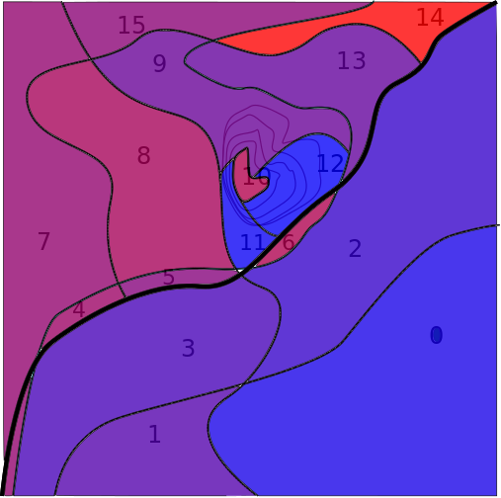
PSR
Region | PSR | Rank
0 | .00030 | 14
1 | .00111 | 11
2 | .00072 | 13
3 | .00094 | 12
4 | .00207 | 5
5 | .00178 | 8
6 | .00233 | 3
7 | .00195 | 6
8 | .00222 | 4
9 | .00138 | 9
10 | .00237 | 2
11 | .00013 | 15
12 | .00007 | 16
13 | .00132 | 10
14 | .00339 | 1
15 | .00185 | 7
You have 200 searcher-hours to allocate
Notes:
At this point, IF TIME ALLOWS AND STUDENTS INTERESTED, let students spend 5-10 minutes trying to come up with an allocation.
Divide into small number of groups depending on class size. If really lousy attendance, individual.
If you do this as an exercise, can use your POS spread sheet (“Scratchpad” sheet) to evaluate the allocations.

Slide 34
Optimal search plan
Compute Probable success rate (PSR)
Charnes-Cooper algorithm:
  Sort areas by PSR
  allocate effort to area of highest PSR to get down to next largest.
Areas with equal PSR get equal POD allocation
  Continue to allocate until all areas have same PSR, or run out of resources.
Operational adjustment and reevaluation
Notes:
Charnes-Cooper is only the simplest allocation algorithm, and only works if there is a single pool of identical resources that can be divided as needed.
If multiple resource kinds, need a more sophisticated algorithm. W and v will be different for each resource kind in each region, problem gets complicated fast.

Slide 35
Charnes-Cooper process

Slide 36
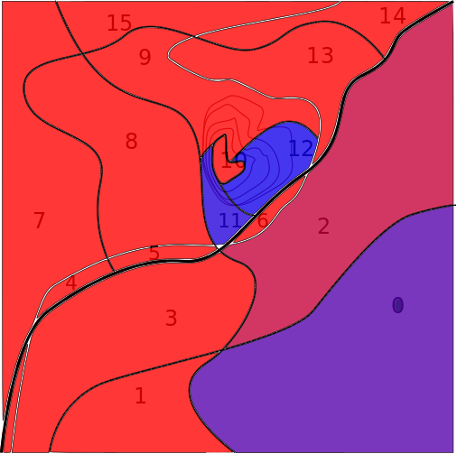
Theoretical optimum
Reg | PSR | t | C | POD | POS
0 | .0003 | 0 | 0 | 0 | 0
1 | .0011 | 24.13 | 0.18 | 0.16 | 0.0245
2 | .0007 | 0 | 0 | 0 | 0
3 | .0009 | 1.76 | 0.017 | 0.016 | 0.0016
4 | .0021 | 3.88 | 0.80 | 0.55 | 0.0055
5 | .0018 | 3.65 | 0.64 | 0.48 | 0.0048
6 | .0023 | 3.95 | 0.92 | 0.60 | 0.0060
7 | .0020 | 38.06 | 0.74 | 0.52 | 0.0524
8 | .0022 | 39.28 | 0.87 | 0.58 | 0.0582
9 | .0014 | 14.40 | 0.40 | 0.32 | 0.0164
10 | .0024 | 19.77 | 0.93 | 0.60 | 0.0304
11 | .0001 | 0 | 0 | 0 | 0
12 | 7e-5 | 0 | 0 | 0 | 0
13 | .0013 | 13.39 | 0.35 | 0.29 | 0.0149
14 | .0034 | 19.10 | 1.30 | 0.73 | 0.0363
15 | .0018 | 18.62 | 0.69 | 0.50 | 0.0248
Post-search PSR
OPOS = 0.276 = 27.6%
Notes:
This allocation from Charnes-Cooper. Optimal search plan, maximum POS given 200 hours of effort.
Sometimes, the theoretical plan may make no operational sense. Some areas may have only a few searcher hours assigned, with tiny POS. This effort could more safely be allocated elsewhere with little impact on OPOS.
Regions 3, 9 , 13 have very low coverage, and we would never actually assign this way.
Theoretically optimal plans are only guidance, not OPERATIONALLY optimal.
Even if have to modify, we can use POS=POC*POD to see how much less than optimal we are, and compare different modifications.

Slide 37
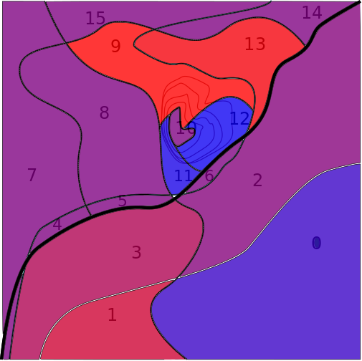
Operationally Viable
region | allocation | coverage | POD
0 | 0 | 0 | 0
1 | 0 | 0 | 0
2 | 0 | 0 | 0
3 | 0 | 0 | 0
4 | 5.36 | 1.11 | 0.67
5 | 5.39 | 0.96 | 0.62
6 | 5.27 | 1.23 | 0.71
7 | 53.89 | 1.05 | 0.65
8 | 53.17 | 1.18 | 0.69
9 | 0 | 0 | 0
10 | 26.29 | 1.24 | 0.71
11 | 0 | 0 | 0
12 | 0 | 0 | 0
13 | 0 | 0 | 0
14 | 23.65 | 1.60 | 0.80
15 | 26.98 | 1.00 | 0.63
Post-search PSR
OPOS = 0.261 = 26.1%
Notes:
This allocation obtained from optimal by reallocating all effort from areas with <0.5 coverage into areas with >=0.5 coverage. Allocation done by making sure each area given equal increments of COVERAGE so that total time allocation adds up to time removed fro low-coverage areas.

Slide 38
Recap
POD only part of story
Maximizing POS with available resources
Optimal plan
Operationally viable plan

Slide 39

Accessible Reference
Frost, “Principles of Search Theory”
Simple explanation using brooms as detectors. Very readable.
https://coloradosarboard.org/csrb-documents/Principles%20of%20Search%20Theory.pdf

Slide 40
Break?

Slide 41
Beyond the first search
Early phases inform late phases
Search redistributes POC
Overall cumulative POS
Factoring in new information

Slide 42
Updated POC map
After searching area i:
At end of period, all searched areas have new POC.
Not 100% --- valuable
ROW

Slide 43
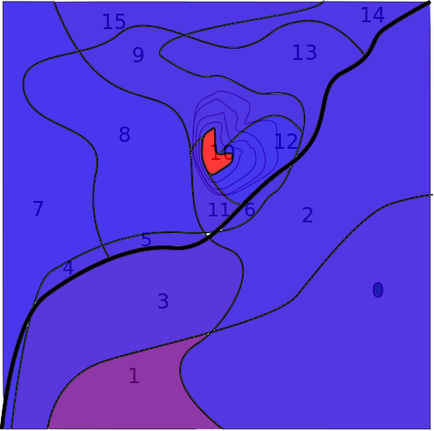
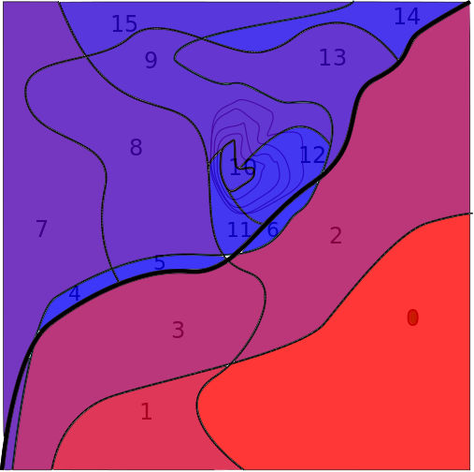
Example
Region | POC_0 | POD | POC_1
0 | 0.15 | 0 | .15
1 | 0.15 | .16 | .125
2 | 0.10 | 0 | .10
3 | 0.10 | .016 | .098
4 | 0.01 | .55 | .004
5 | 0.01 | .48 | .005
6 | 0.01 | .60 | .004
7 | 0.10 | .52 | .047
8 | 0.10 | .59 | .042
9 | 0.05 | .32 | .034
10 | 0.05 | .61 | .020
11 | 0.01 | 0 | .01
12 | 0.01 | 0 | .01
13 | 0.05 | .29 | .035
14 | 0.05 | .73 | .014
15 | 0.05 | .50 | .025
POC_0
POC_1
PDEN_0
PDEN_1
POC now sums to 0.7237
Notes:
This example returns to the “optimum” allocation, not the viable one.

Slide 44
Overall Cumulative POS
POS in area i after nth search of that area
Overall POS of nth search, sum over areas
Cumulative overall POS:sum over all searches
Cumulative OPOS: Measure of effectiveness of all searching so far.

Slide 45
Cumulative POD
Repeated search of an area
Total effect of all searches of that area
POD only one piece of puzzle, OPOS more important

Slide 46
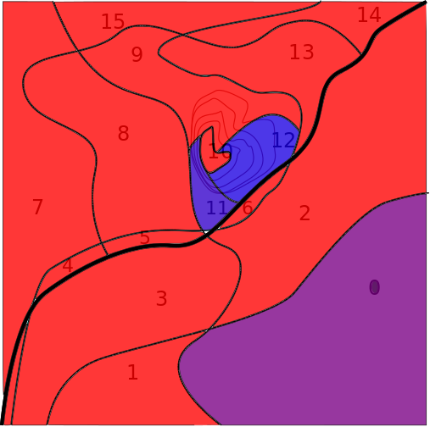
Second phase optimum
Region | t_2 | C_2 | POD_2 | POS_2
0 | 0 | 0 | 0 | 0
1 | 50.67 | 0.375 | 0.313 | 0.0392
2 | 16.65 | 0.11 | 0.113 | 0.0113
3 | 39.72 | 0.375 | 0.313 | 0.0307
4 | 1.81 | 0.375 | 0.313 | 0.0014
5 | 2.11 | 0.375 | 0.313 | 0.0016
6 | 1.61 | 0.375 | 0.313 | 0.0012
7 | 19.22 | 0.375 | 0.313 | 0.0149
8 | 16.88 | 0.375 | 0.313 | 0.0131
9 | 13.56 | 0.375 | 0.313 | 0.0105
10 | 7.92 | 0.375 | 0.313 | 0.0061
11 | 0 | 0 | 0 | 0
12 | 0 | 0 | 0 | 0
13 | 14.17 | 0.375 | 0.313 | 0.0110
14 | 5.53 | 0.375 | 0.313 | 0.0043
15 | 10.15 | 0.375 | 0.313 | 0.0078
OPOS = .153 (15.3%) OPOS_cum= 42.9%
Notes:
Again, the “optimal” allocation may not make any operational sense, and will need modification.
This second phase computation starts from first stage optimum solution, computes second phase optimum.
After modification, recompute OPOS to see how far off from optimal the operationally viable plan will be.

Slide 47
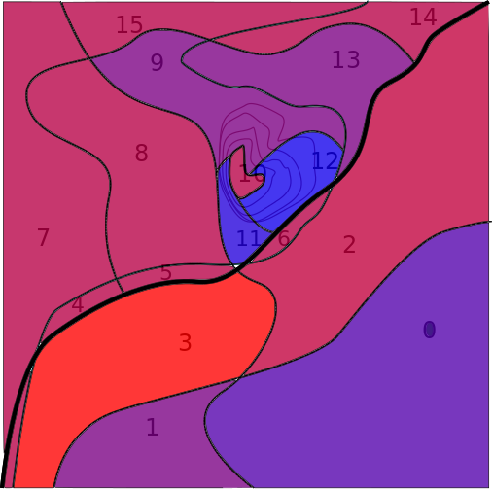
Second phase, viable
region | allocation | coverage | POD
0 | 0 | 0 | 0
1 | 119.83 | 0.89 | 0.59
2 | 0 | 0 | 0
3 | 0 | 0 | 0
4 | 0 | 0 | 0
5 | 0 | 0 | 0
6 | 0 | 0 | 0
7 | 0 | 0 | 0
8 | 0 | 0 | 0
9 | 40.01 | 1.10 | 0.67
10 | 0 | 0 | 0
11 | 0 | 0 | 0
12 | 0 | 0 | 0
13 | 40.15 | 1.06 | 0.65
14 | 0 | 0 | 0
15 | 0 | 0 | 0
OPOS = .154 (15.4%) OPOS_cum= 41.6%
Notes:
This computation starts from first phase 'viable' allocation, finding optimum second phase allocation, and applying the same “no area less than .5 coverage” reallocation algorithm.
Note that this second phase has a higher OPOS than the “optimum” --- this is because they started from different initial distributions. The first stage optimum left less probability to sweep up on the second phase!

Slide 48
Using Search Theory
Early information gathering
Resource Allocation
Tactical assignment
Post-search information
Lather, Rinse, Repeat

Slide 49
Initial Search: Reflex Tasks
Bike wheel
Reflex task assignments
Gather info in debriefs
  Decision points
  Hazards & conditions
  Rd measurements
  Travel speeds

Slide 50
Planning
If go beyond reflex tasks into area search
Establish initial POC map
Determine resource needs
Discover resource availability
Resource allocation
Tactical assignments

Slide 51
Operations
Brief resources
  Expected time on task
  Assigned area
  Rd measurement
  Total-track-length measurement (via GPS)

Slide 52
Operations®Planning
Debrief resources
Collect Rd measurements
Collect total track lengths
Speeds?
Terrain
Hazards
Completeness

Slide 53
Planning
Post-search objective POD
Updated POC map
Other new information into POC map
OPOS
OPOS_cum
Next phase plan with updated POC map
  resources available
  allocation

Slide 54
Myths and Misconceptions
Many people believe many untrue things about search theory!
Notes:
Subjective POD
Critical separation
Multiple search (Elevated POD)
Segmentation

Slide 55
Subjective POD
Myth:
“Searchers can estimate POD directly.”
“I can tell searchers what POD to get.”
Reality:
People are really bad at estimating probability!
“Searchers always overestimate POD?”

Slide 56
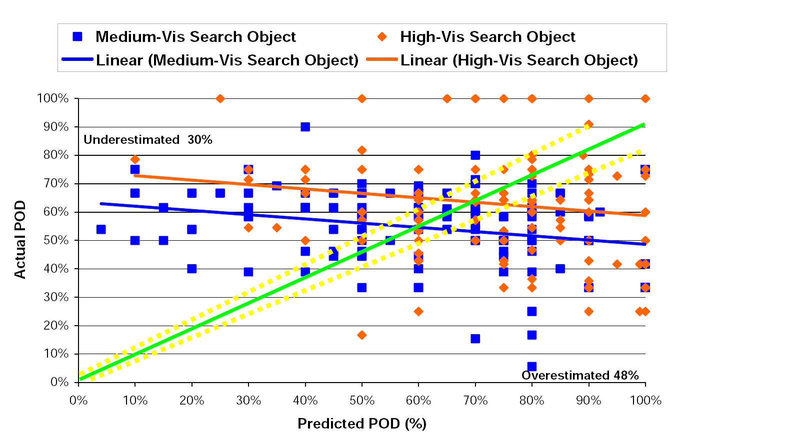
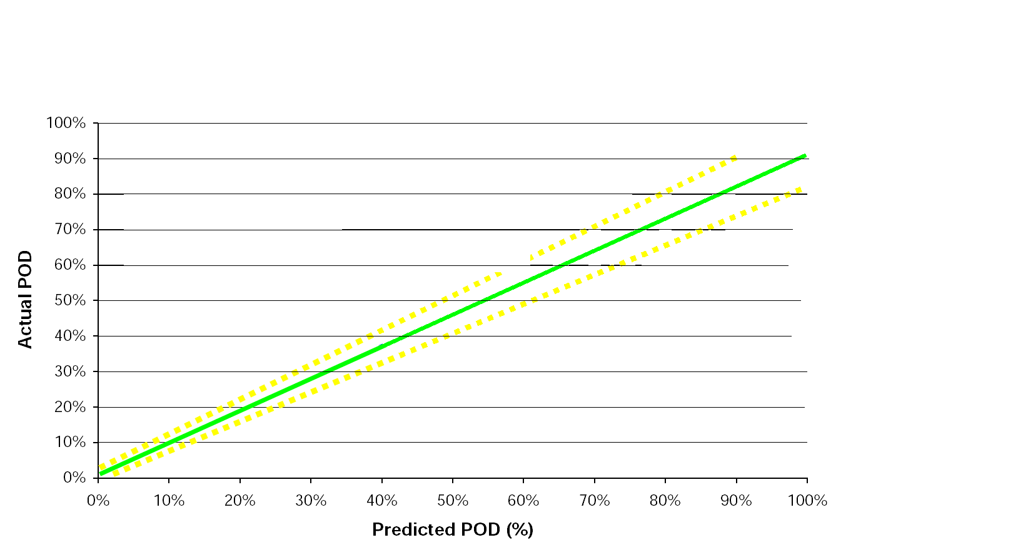
Subjective POD

Slide 57
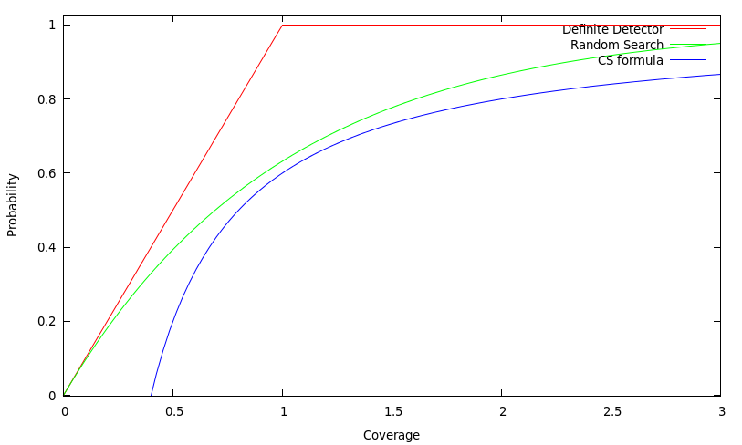
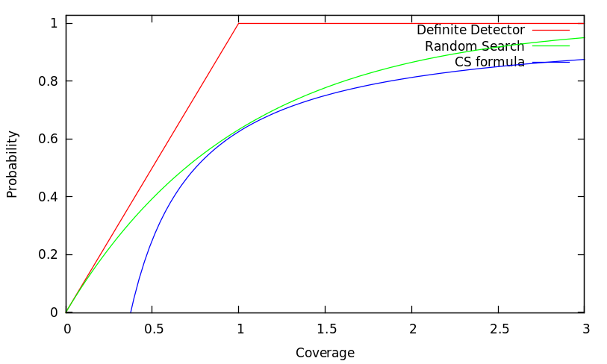
Critical Separation
Observation: 50% POD spaced 2*Rd
Deduced formula POD vs. Spacing: BAD!
“Purposeful wandering” – invalidates both
Search theory predicts observation if W=1.5*Rd
W=1.6Rd still close to 50%
Search theory provides more usable prediction
There is nothing “critical” about “critical separation!”
Notes:
Wartes experiments (1974)
Perkins (1989)
Compatibility of experimental observations with search theory
Spacing searchers at 2*Rd got 50% POD
Incompatibility of conclusions with search theory
POD vs. Spacing formula
POD vs. Coverage implication

Slide 58
Segmentation
Segmentation: division of regions to meet operational/tactical needs
Segmentation NOT the first step
New ideas: segmentation not even necessary (requires GIS and record of exact searcher tracks)
Notes:
Many search management classes overemphasize importance of segmentation.
Some even say that you should segment into “searchable” segments (4-6 hours) as very early step of planning.
Segmenting this way means prejudging how effort will be allocated.
Segment AFTER allocation of resources to planning regions as OPERATIONAL/LOGISTICAL step.
Segmentless planning is controversial new idea, absolutely cannot be done without careful record-keeping. GIS practically essential, GPS absolutely essential.

Slide 59
What now?
STOP asking “What was your POD?”
STOP saying “Search to X POD.”
STOP teaching “Critical Separation.”
START briefing/debriefing for objective POD
START training to measure Rd every time
START training to collect total track length
START using objective POD
Notes:
If collect Rd in training exercises in common search areas, will have data to use in searches for planning purposes.
If collect Rd during hasty searches before needed, will have usable data for planning if goes beyond hasty search!
If teams used to measuring Rd they will do it.
If teams used to being asked for total track length, will learn to collect it.

Slide 60
What Now?
START learning how to use GIS to integrate data into planning
START developing group of tech specialists
Keep learning!
Notes:
These are things we can do as a community rather than what individuals in the audience can do themselves.

Slide 61

For further reading
http://pages.swcp.com/~russo/searchtheoryrefs.html

